Slide 1
Generative Adversarial Networks
Putikhin N
Yaushkina A
Borovkova D
Ustavshikov D
Samoylov M
Martirosyan A

Slide 2
What is GAN?
GANs or Generative Adversarial Networks are a kind of neural networks that is composed of 2 separate deep neural networks competing each other: the generator and the discriminator.
Goal: generate data points that are similar to some of the data points in the training set.

Slide 3
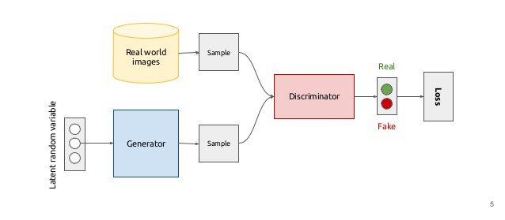
Basic idea behind GAN for image generation

Slide 4
Common issues with GANs
GANs are unstable to train
Convolution networks require special tweaking to use with GANs

Slide 5
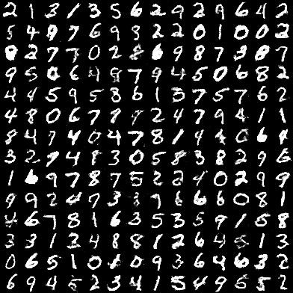
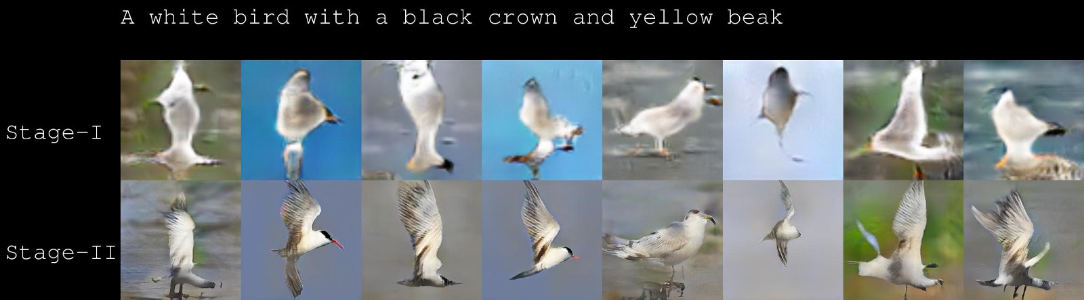
What is it used for?
Image generation

Slide 6
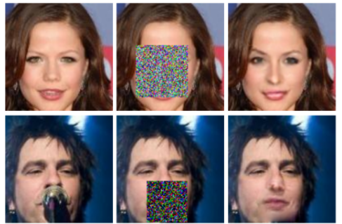
What is it used for?
Face completion
Original Masked Restored

Slide 7
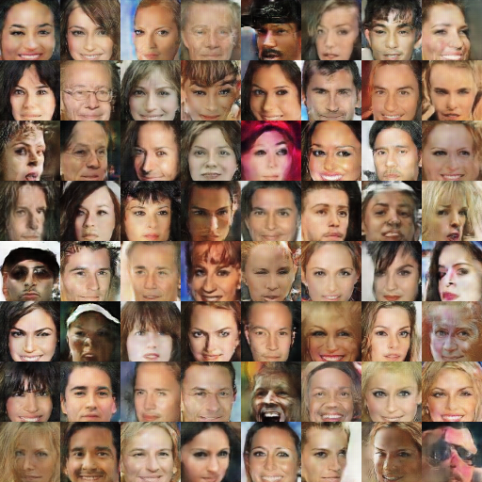
What is it used for?
Face generation

Slide 8
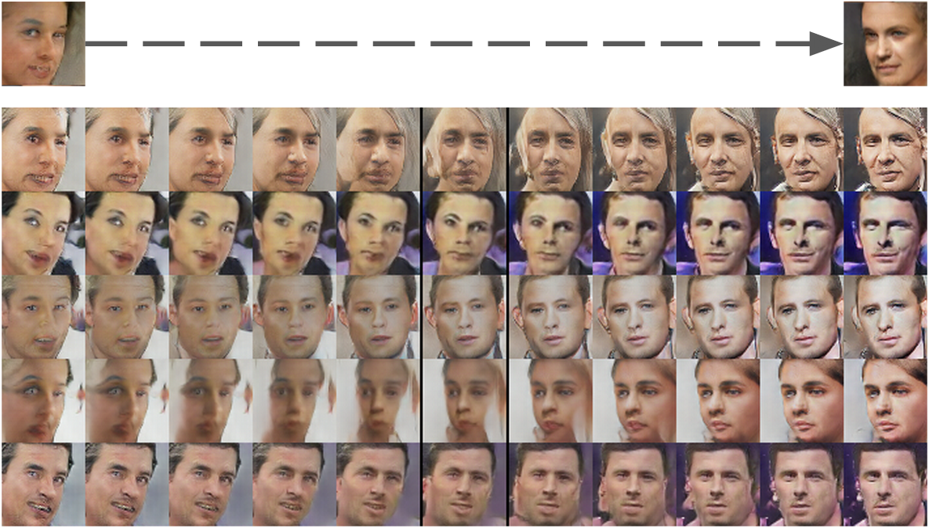
Interpolation (of generated images)

Slide 9
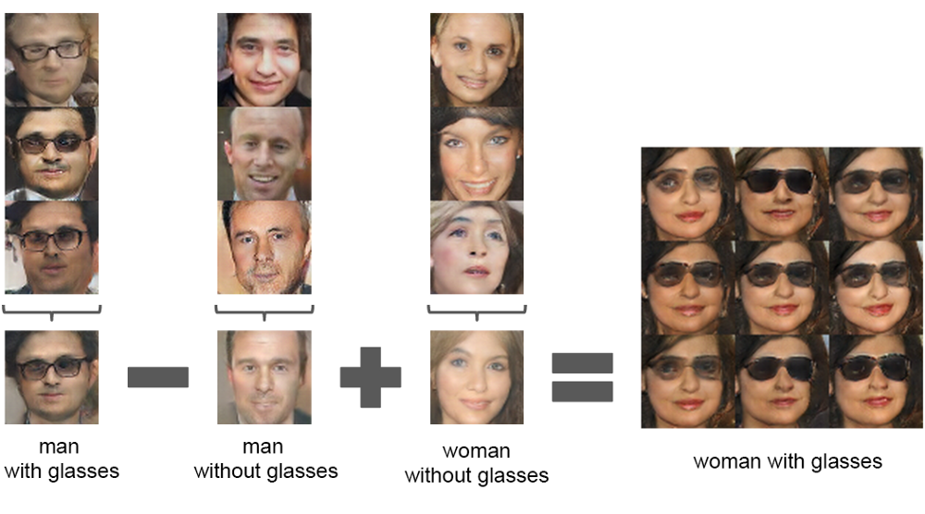
Some more interesting stuff
Arithmetic on abstract ideas

Slide 10
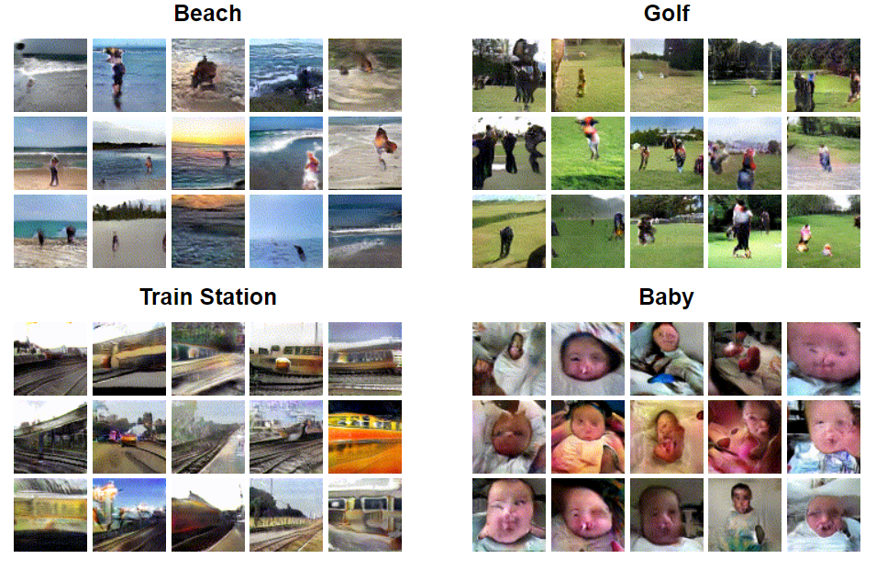
What is it used for?
Video generation (http://carlvondrick.com/tinyvideo/)

Slide 11
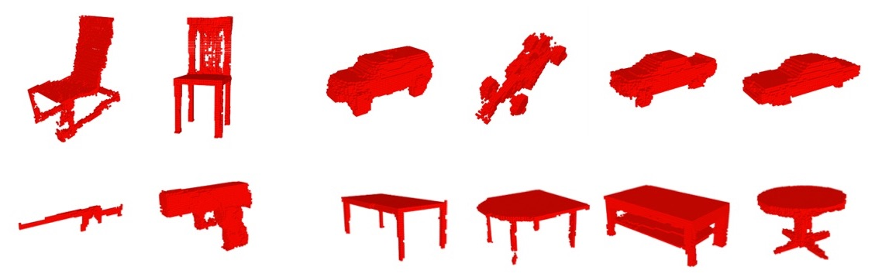
What is it used for?
3D object generation

Slide 12
Our ideas
Car generation
Handwriting generation
Painting generation

